Slide 1


Part I
2. Process Modeling
Dimitris SACHARIDIS
2023-2024

Slide 2















BPM lifecycle
Process identification
Process
discovery
Process monitoring and controlling
Process
analysis
Process
implementation
Process
redesign
2

Slide 3




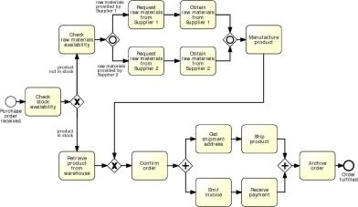


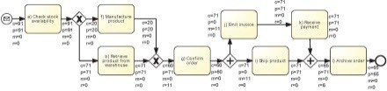
Purposes of process modeling
Process Modeling
The reason for modeling a process is to understand the process and to share our understanding of process with people who are involved with it on a daily basis.
Communication Documentation Analysis
Communication
Documentation
Analysis (e.g. simulation)
Process identification
Conceptual
PPrroocceessss aarrcchhiitteeccttuurree
CCoonnffoorrmmaannccee aanndd
ppeerrffoorrmmaannccee iinnssiigghhtts
Process discovery
As-is process model
s
Process monitoring and controlling
Executable
Process analysis
Executable process model
IInnssiigghhttss oonn
eaakknneesssseess aanndd
thheeiirr iimmppaacctt
ww
t
Process implementation
Process redesign
Automation
Testing
To-be process model
Conceptual
3

Slide 4

Business Process Model and Notation (BPMN)
OMG standard (nowadays BPMN 2.0)
Both for conceptual and executable models
Supported by numerous tools: bpmn.org lists over 70 tools, incl.
Camunda
Apromore
Signavio
Bizagi Process Modeler
Cameo Business Analyst

Slide 5
BPMN from 10,000 miles…
A BPMN process model is a graph consisting of four types of core
elements:
It involves events and activities
Events represent thing that happen instantaneously (Ex: invoice has been received) Activities represent units of work that have a duration (Ex: an activity to pay an invoice)
Events and Activities are logically related by sequence
start end event
activity
gateway
sequence flow

Slide 6
Let’s start modeling
Order-to-cash
An order-to-cash process is triggered by the receipt of a purchase order from a customer. Upon receipt, the purchase order has to be checked against the stock to determine if the the requested item(s) are available. Depending on stock availability the purchase order may be confirmed or rejected.
If the purchase order is confirmed, an invoice is emitted, and the goods requested are shipped. The process completes by archiving the order.

Slide 7
Let’s start modeling – break it down
Order-to-cash
An order-to-cash process is triggered by the receipt of a purchase order from a customer.
Upon receipt, the purchase order has to be checked against the stock to determine if the requested item(s) are available.
Depending on stock availability the purchase order may be confirmed or rejected.
If the purchase order is confirmed, an invoice is emitted and the goods requested are shipped. The process completes by archiving the order.

Slide 8
Let’s start modeling – break it down
Order-to-cash
An order-to-cash process is triggered by the receipt of a purchase order from a customer.
Upon receipt, the purchase order has to be checked against the stock to determine if the requested item(s) are available.

Slide 9

BPMN Model
Order-to-cash
Check stock
availability
Purchase
order
received
Naming conventions
Event: noun + past-participle verb (e.g., insurance claim lodged)
Activity: verb + noun (e.g., assess credit risk)
9

Slide 10
Let’s start modeling – break it down
Order-to-cash
An order-to-cash process is triggered by the receipt of a purchase order from a customer.
Upon receipt, the purchase order has to be checked against the stock to determine if the requested item(s) are available.
Depending on stock availability the purchase order may be confirmed or rejected.
If the purchase order is confirmed, an invoice is emitted and the goods requested are shipped. The process completes by archiving the order.

Slide 11
BPMN Model
Order-to-cash
end event
activity
Reject order
Items not in stock
Order rejected
split gateway
Check stock availability
end event
Archive
order
Purchase order received
start
event
Items in stock
Confirm
order
Emit
invoice
Ship goods
Order fulfilled

Slide 12




Execution of a process model “Game of Tokens”
Order #1
Order #2
Order #3
Reject order
Items not in stock
Order rejected
Check stock
availability
Purchase order received
Items in stock
Confirm
order
Emit invoice
Ship goods
Archive
order
Order fulfilled

Slide 13
A little bit more on events…
A start event triggers a new process instance by generating a token that traverses the sequence flow (“tokens source”)
start event
An end event signals that a process instance has completed with a given outcome by consuming a token (“tokens sink”)
end event

Slide 14
Order-to-cash example revisited…
[…] If the purchase order is confirmed, an invoice is emitted and the goods requested are shipped (in any order). The process completes by archiving the order. […]
Reject order
Items not in stock
Order rejected
Check stock
availability
Purchase order received
Items in stock
Confirm
order
Emit invoice
Ship goods
Archive
order
Order fulfilled

Slide 15
First try
Order-to-cash
Reject order
Items not in stock
Check stock
availability
OOrrder rejected
split
Emit invoice
Purchase oorrddeerr received
IItteemmss iinn
stock
CCoonfirm order
Emit invoice
Ship goods
Archive order
join
OOrrddeerr
fulfilled
split
Ship goods

Slide 16


A little more on gateways: XOR Gateway
An XOR Gateway captures decision points (XOR- split) and points where alternative flows are merged (XOR-join)
condition
XOR-split ➔ takes one outgoing branch
¬ condition
XOR-join ➔ proceeds when one incoming branch has completed

Slide 17
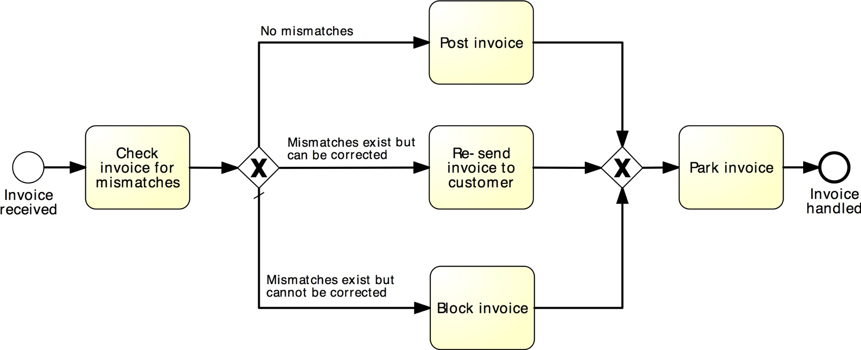

Example: XOR Gateway
Invoice checking process

Slide 18


A little more on gateways: AND Gateway
An AND Gateway provides a mechanism to create and synchronize “parallel” flows.
AND-split ➔ takes all outgoing branches
AND-join ➔ proceeds when all incoming branches have completed
18

Slide 19
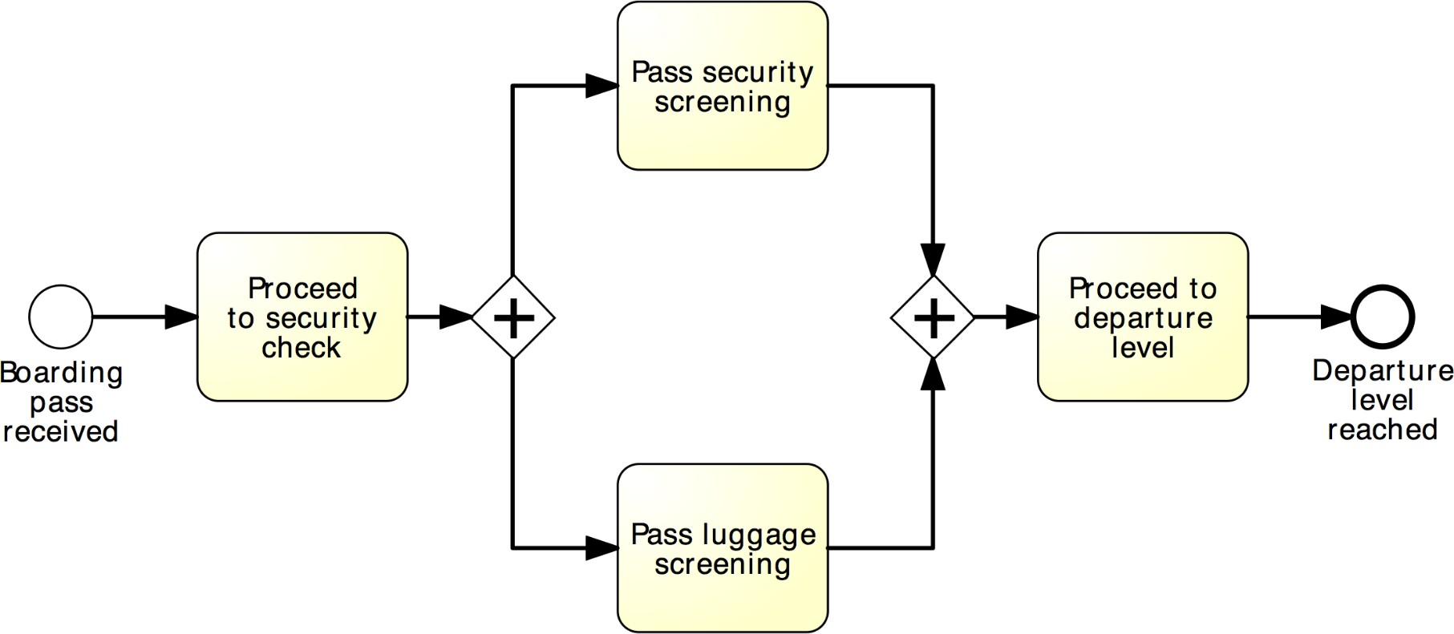

Example: AND Gateway
Airport security check

Slide 20
Revised order-to-cash process model
Reject order
Items not in stock
Order rejected
Check stock
availability
XOR-split
Send invoice
Purchase order received
Items in stock
Confirm order
Archive
order
AND-split
AND-join
Order fulfilled
Ship goods

Slide 21
Between XOR and AND
Order distribution process
A company has two warehouses that store different products: Amsterdam and Hamburg. When an order is received, it is distributed across these warehouses: if some of the relevant products are maintained in Amsterdam, a sub-order is sent there; likewise, if some relevant products are maintained in Hamburg, a sub-order is sent there. Afterwards, the order is registered and the process completes.

Slide 22
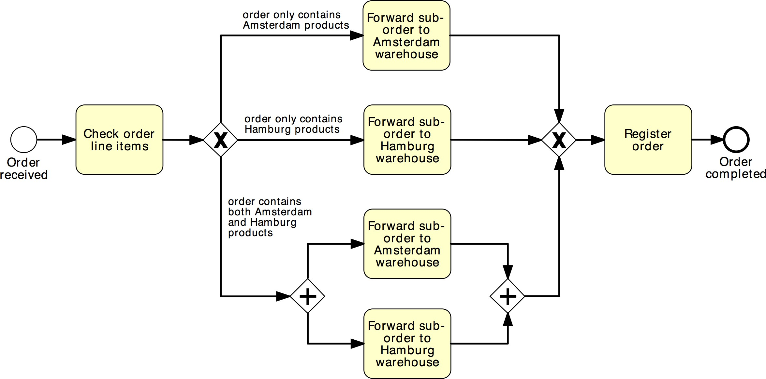
Solution 1
Order distribution process
XOR-split
XOR-join
AND-split
AND-join

Slide 23
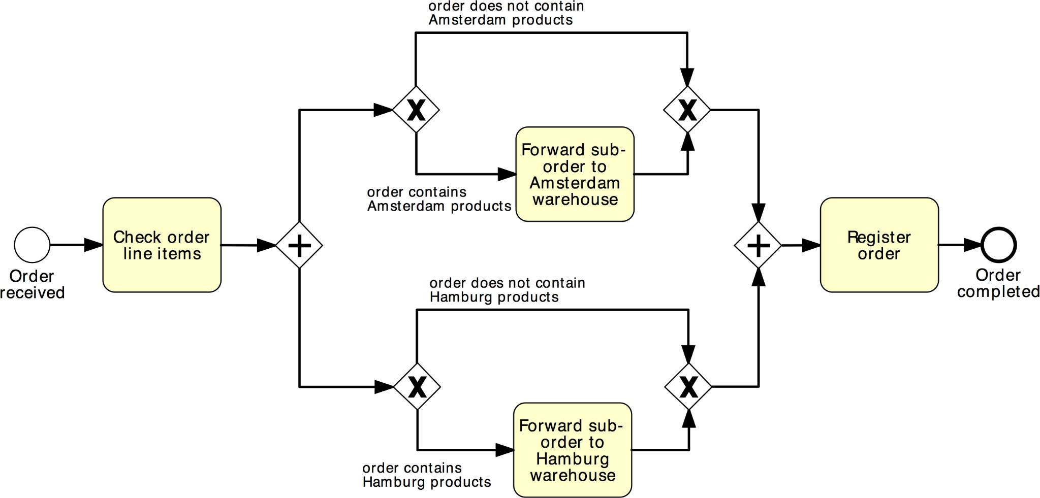
Solution 2
Order distribution process
AND-split
AND-join
XOR-split
XOR-join

Slide 24
OR Gateway
An OR Gateway provides a mechanism to create and synchronize n out of m parallel flows.
cond₁
OR-split ➔ takes one or more branches depending on conditions
cond
n
OR-join ➔ proceeds when all active incoming branches have completed
24

Slide 25
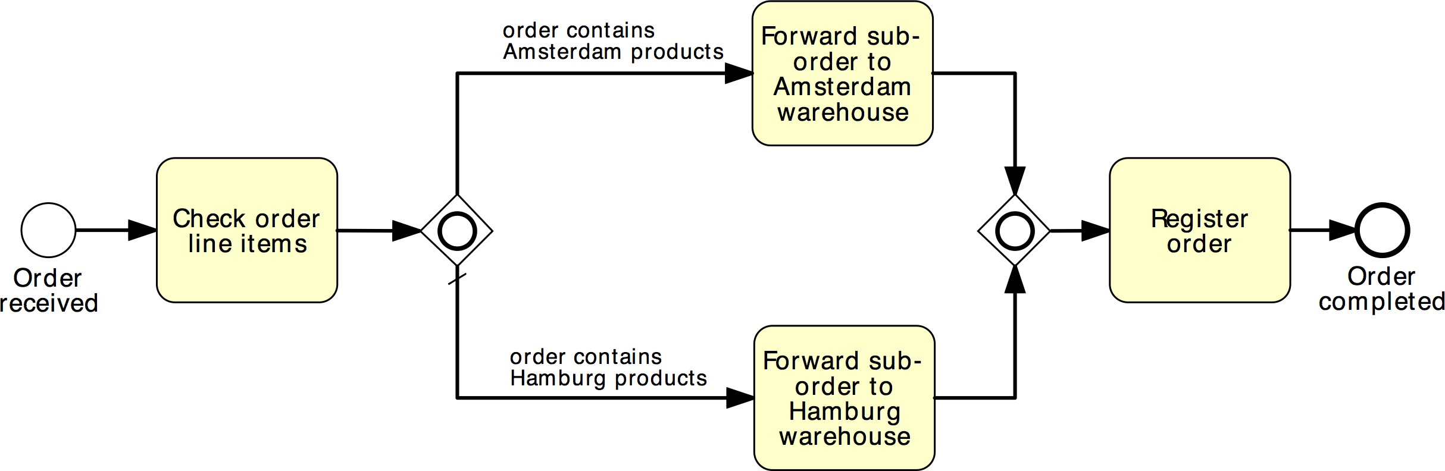

Solution using OR Gateway
Order distribution process

Slide 26
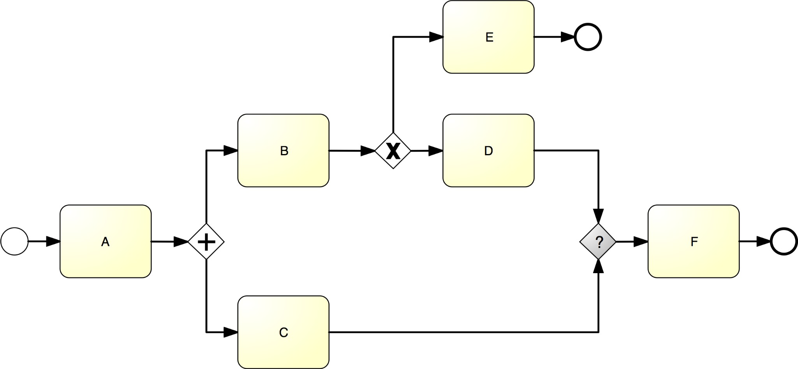
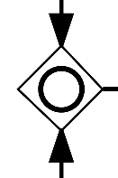
What join type do we need here?

Slide 27

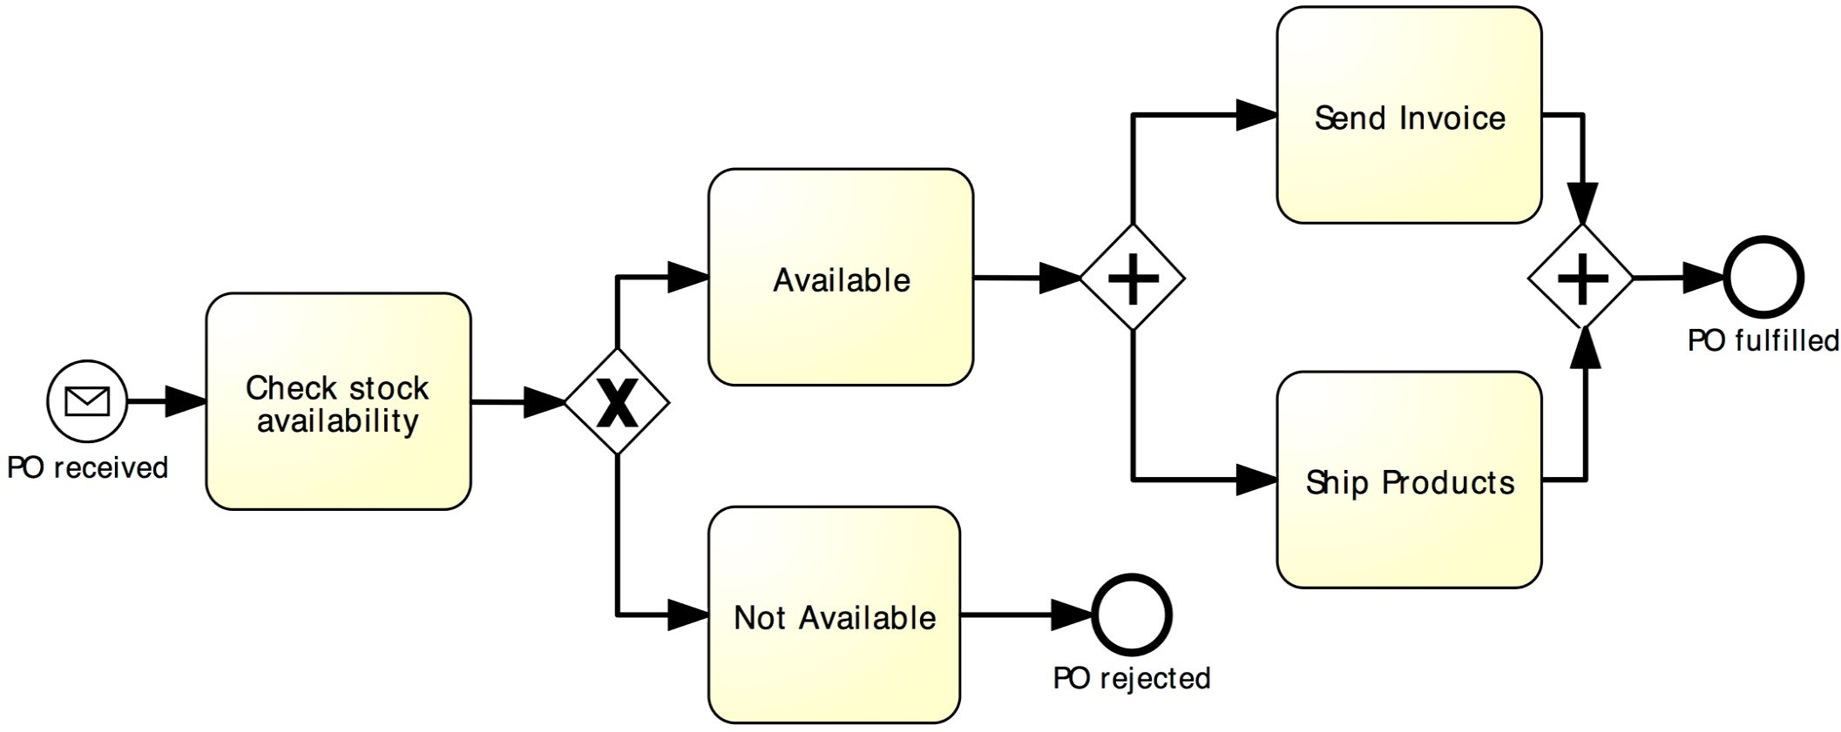
Beware: Beginner’s Mistake…

Slide 28
Guidelines: Naming Conventions
Give a name to every event and task
For tasks: verb followed by business object name and possibly complement
Issue Driver Licence, Renew Licence via Agency
For message events: object + past participle
Invoice received, Claim settled
Avoid generic verbs such as Handle, Record…
Label each XOR-split with a condition
Policy is invalid, Claim is inadmissible

Slide 29





Poll: Which model do you prefer?
Mat$r&al&($
*+ma&n m+*$l
A/0tra1t 2ar&a/&l&t3
;&< +5t&mal 5at: 5aram$t$r0
Nex$ &n$e()*$&+n s$ep.
/es
9$n$rat$ 0&7n&6&1ant 5at:0
9$n$rat$
+5t&mal 5at: 1+m/&nat&+n
4$l$1t 6&r0t 08/030t$m
45$1&63
&nt$7rat$* 08/030t$m
n+
=:++0$
n$<t 08/030t$m
9$n$rat$ r$5+rt
Mat$r&al&($
*+ma&n m+*$l
A/0tra1t 2ar&a/&l&t3
Nex$ &n$e()*$&+n s$ep.
/es
;&< +5t&mal 5at: 5aram$t$r0
A/0tra1t 2ar&a/&l&t3
9$n$rat$ 0&7n&6&1ant 5at:0
9$n$rat$
+5t&mal 5at: 1+m/&nat&+n
4$l$1t 6&r0t 08/030t$m
45$1&63
&nt$7rat$* 08/030t$m
n+
=:++0$
n$<t 08/030t$m
45$1&63
&nt$7rat$* 08/030t$m
9$n$rat$ r$5+rt

Slide 30
One more guideline…
Model in blocks
Pair up each AND-split with an AND-join and each XOR-split with a XOR-join, whenever possible
Exception: sometimes a XOR-split leads to two end events – different outcomes (cf. order management example)

Slide 31
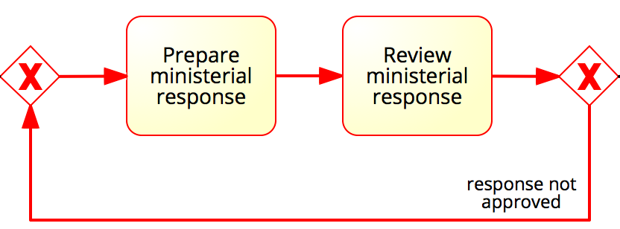
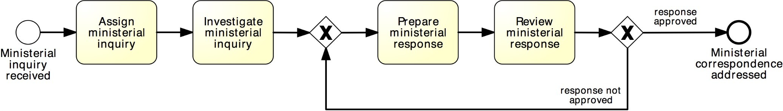
Rework and repetition
Address ministerial correspondence
In the minister’s office, when a ministerial inquiry has been received, it is registered into the system. Then the inquiry is investigated so that a ministerial response can be prepared.
The finalization of a response includes the preparation of the response itself by the cabinet officer and the review of the response by the principal registrar. If the registrar does not approve the response, the latter needs to be prepared again by the cabinet officer for review. The process finishes only once the response has been approved.
XOR-join: entry point
XOR-split: exit point
31

Slide 32
Quick Note: Implicit vs. explicit gateways
A
A
=
C
C
B
B
B
B
=
A
A
C
C

Slide 33
How this process starts? How it ends?
Collect
mail
Sort
mail
New mail
arrived
Document requisition compiled
Not acceptable
Register
mail
Check mail for
compliance
Compile document requisition
New email arrived
Acceptable
Document response prepared
Capture
matter details
Prepare document response
Physical file printed
Print
physical file
Pay fee
Capture party
details

Slide 34
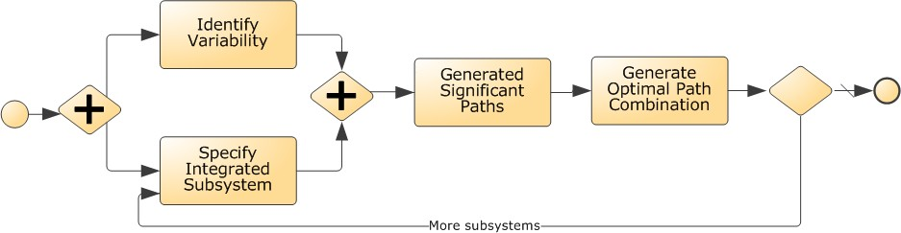
What’s wrong with this model? How to fix it?
X

Slide 35


Process Modelling Viewpoints
Organization
Who?
Lanes & Pools
What?
Tasks Events
BPMN provides two constructs to model resources: pools and lanes.
Pools are generally used to model resource classes, lanes are used to partition a pool into
sub-classes or single resources.
Lanes can be nested within each other in multiple levels.
For example, if we need to model both a department and the roles within that department, we can use
one outer lane for the department, and one inner lane for each role.
When?
Flows Gateways
Which?
Data Objects, Stores
Data / Materials
Pools and lanes are depicted as horizontal rectangles within which we can place activities, events, gateways and data objects relevant to that class.
The name of the pool or lane is
shown vertically on the left-hand side of a horizontal rectangle

Slide 36
Organizational Elements in BPMN – Pools & Lanes
Pool
Captures a resource class. Generally used to model a business party (e.g. a whole company)
Pool
Lane
A resource sub-class within a pool.
Generally used to model
departments (e.g. shipping, finance), internal roles (e.g.
Manager, Associate), software systems (e.g. ERP, CRM
)
Lane
Pool
Lane Lane
Lane
36

Slide 37

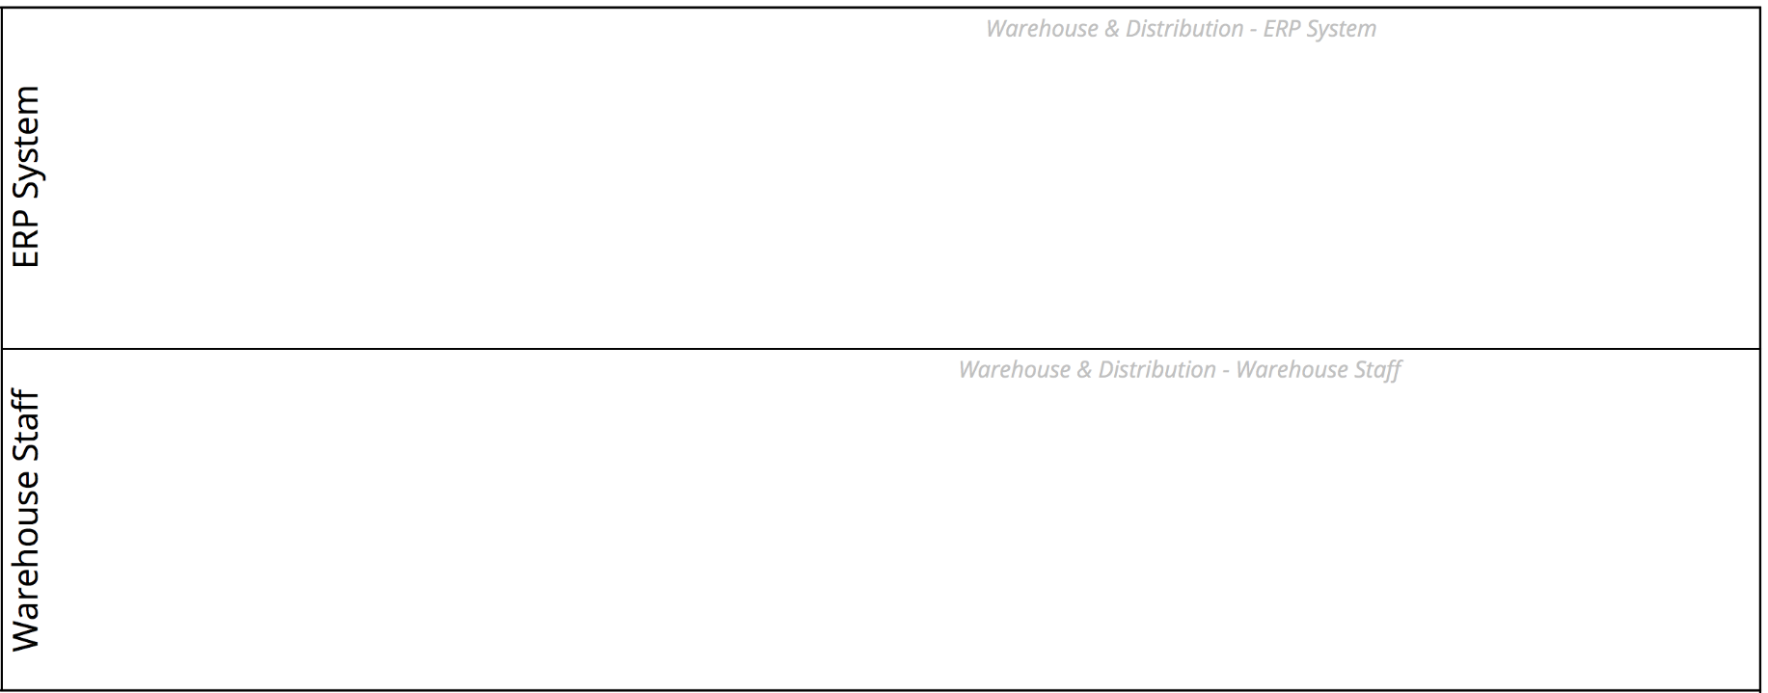
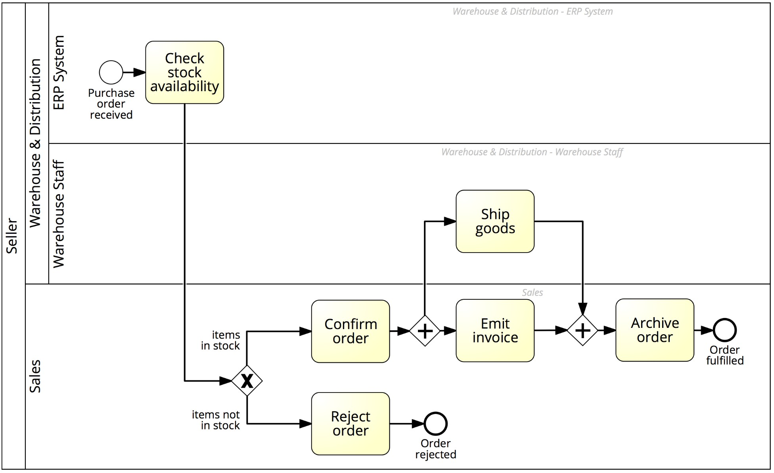

Order-to-cash process with lanes

Slide 38
Message Flow
A Message Flow represents a flow of information between
two
process parties (
Pools)
Message
A Message Flow can connect:
directly to the boundary of a Pool ➔ captures an informative message
to/from that party
to a specific activity or event within that Pool ➔ captures a message
that triggers a specific activity/event within that party
Pool 2
Pool 2 | Receive
Pool 1
 | Send
Pool 1
Send
Receive
38

Slide 39
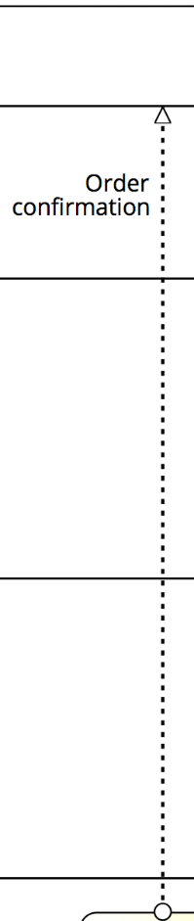
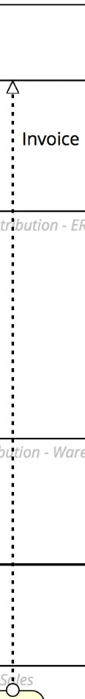
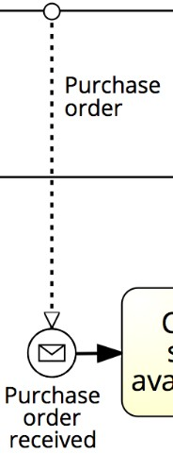
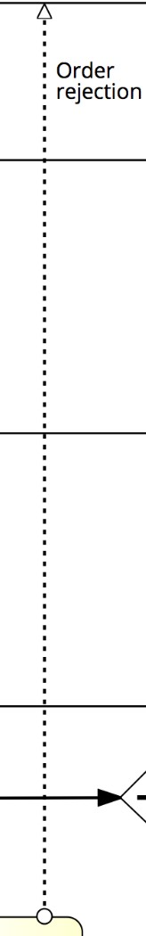
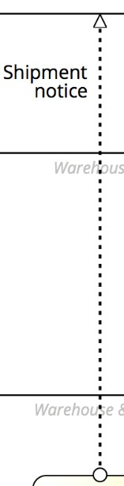
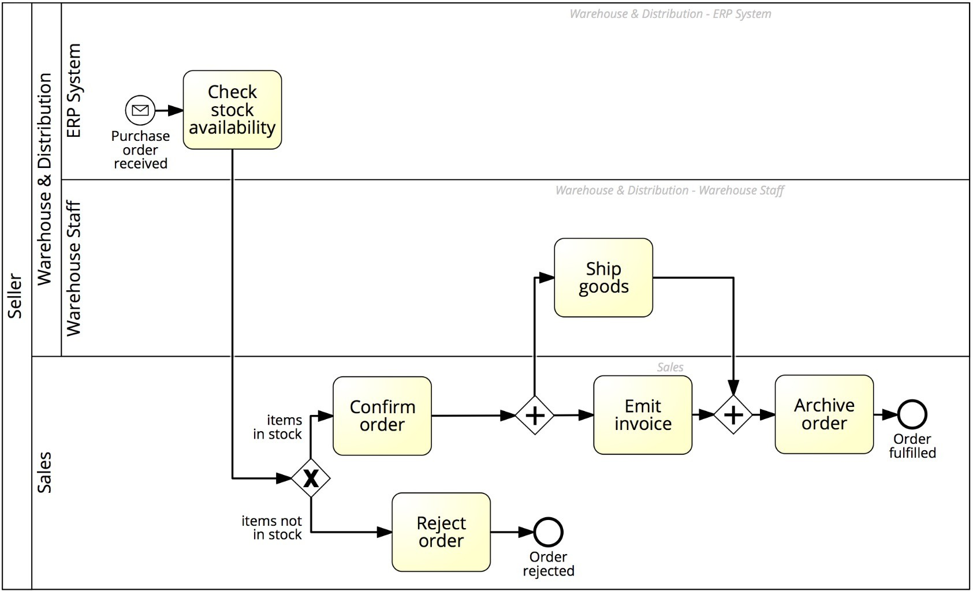
Order-to-cash process with a black-box customer pool
39

Slide 40
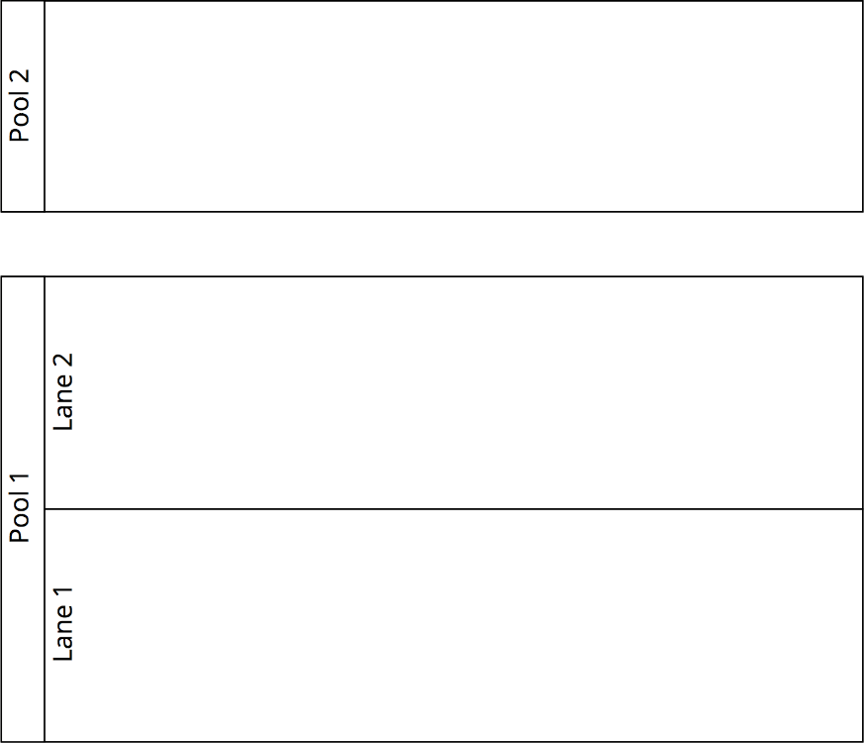

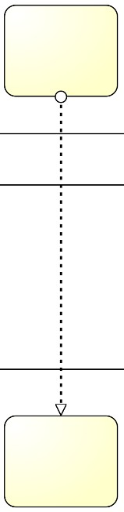
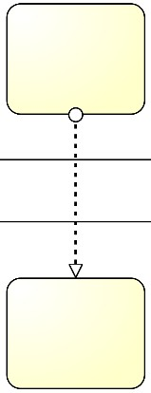


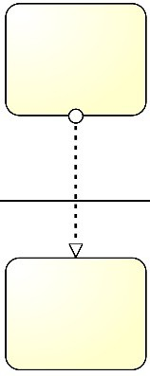
Pools, Lanes and Flows: syntactic rules
A Sequence Flow cannot cross the boundaries of a Pool (message flows can)
Both Sequence Flow and Message Flow can cross the boundaries of Lanes
A Message Flow cannot connect two flow elements within the same pool

Slide 41
One more guideline…
Start modeling with one single “white-box” pool
Initially, put the events and tasks in only one pool – the pool of the party who is running the process
Leave all other pools “black-boxed”
Once you have modeled this way, and once the process diagram inside the white-box pool is complete, you can model the details (events and tasks) in the other pools if that is useful.
In this course we will only model processes with one single white-box pool – all other pools are black-box

Slide 42
Process Modelling Viewpoints
Which?
Data Objects, Stores
Data / Materials

Slide 43



_{BPMN Information Artifac}or_{t}ge_{s}nerated as an output by some activity
Data Object that is
required as an input in order to perform an activity
Ex:
We make use of database to check if an item is available. Here, retailer database can be considered as artifact
Once invoice is generated, it is sent to customer. Here, invoice can also be considered as artifacts
A Data Object captures an artifact required (input) or produced (output) by an activity.
Can be physical or electronic
Purchase
Invoice
order
Emit invoice
A Data Store is a place containing data objects that must be persisted beyond the duration of a process instance.
It is used by an activity to store (as output) or retrieve (as input) data objects.
Oracle CRM
Client info
Retrieve client
information

Slide 44
Order-to-cash process, again
Send
invoice
Confirm
order
Archive
order
Items in stock
Order fulfilled
Check stock
availability
Items not in stock
Ship goods
Purchase order received
Reject order
Order rejected
The purchase order document serves as an input to the stock availability check. Based on the outcome of this check, the status of the document is updated, either to “approved” or “rejected”. If the order is approved, an invoice and a shipment notice are produced.

Slide 45
Model with information artifacts
Purchase
Order
Invoice
Purchase
Order
Purchase Order
Purchase Order [checked]
Send invoice
Confirm
order
Archive
order
Items in stock
Order fulfilled
Check stock
availability
Ship goods
Purchase order received
Items not in stock
Reject order
Order rejected
Purchase Order
Orders DB
Shipment notice
Warehouse DB
Purchase Order [rejected]
Purchase Order [approved]
Beware: This diagram is a too detailed. It is for illustration purposes. In practice, try to only model the most important data objects and associations. Keep the model readable.
45

Slide 46
A Final Note: BPMN Text Annotations
A Text Annotation is a mechanism to provide additional text information to the model reader
Doesn’t affect the flow of tokens through the process
Includes packaging
For blocked invoices
Ship goods
Clear vendor line items

Slide 47
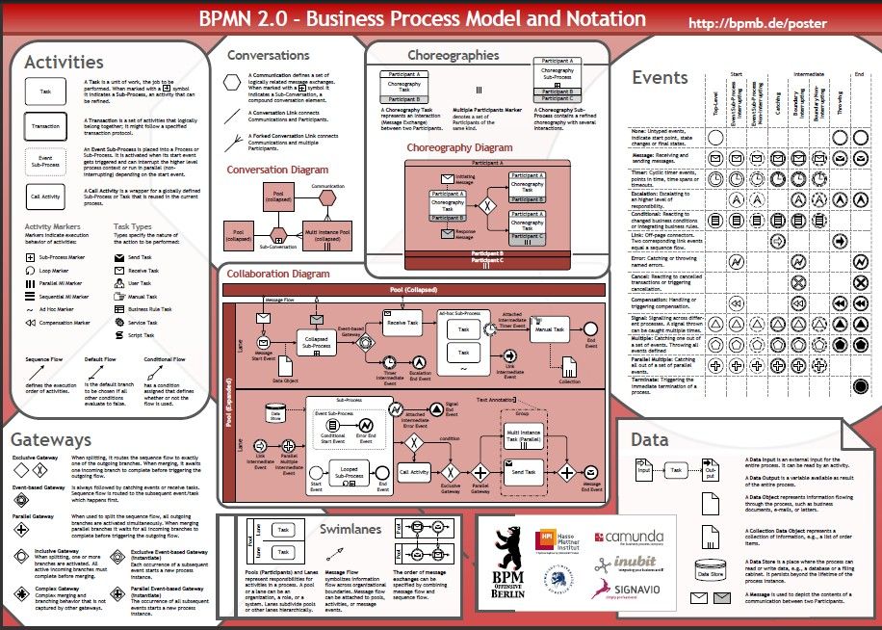
BPMN Poster

